Slide 1
Practice Questions & Nested Structure

Slide 2
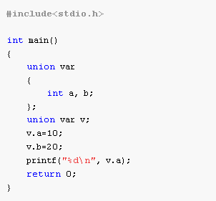
Predict Output (1)

Slide 3
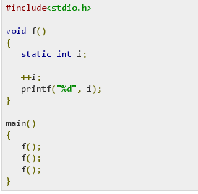
(2)

Slide 4
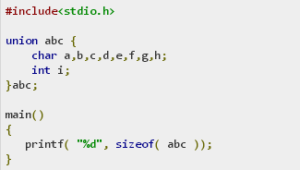
(3)

Slide 5
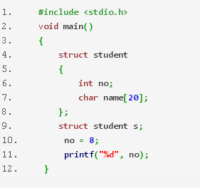
(4)

Slide 6
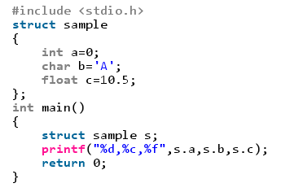
(5)

Slide 7
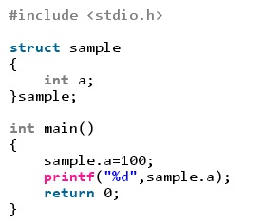
(6)

Slide 8
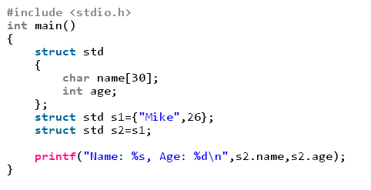
(7)

Slide 9
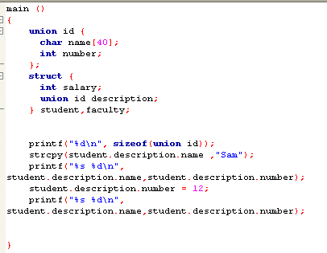
(8)

Slide 10
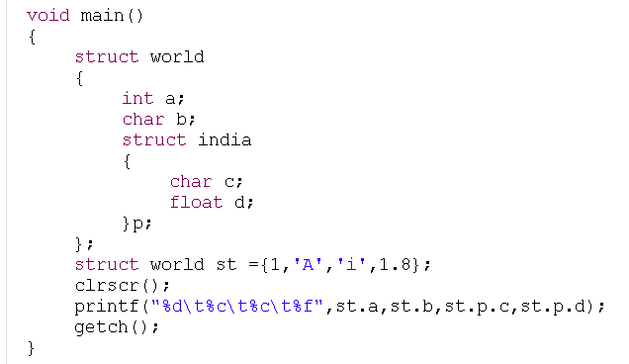
(9)

Slide 11
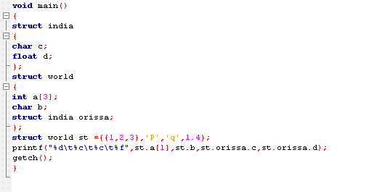
(10)

Slide 12
Ans: 20
1,2,3
4
Compile time error
Error: Can not initialize members here
100
Mike,26.
40,Sam 7168339, 12
1 A I 1.800000
2 p q 1.400000

Slide 13
Nested Structure
Structure with in structure.
Nested structure in C is nothing but structure within structure. One structure can be declared inside other structure as we declare structure members inside a structure.
The structure variables can be a normal structure variable or a pointer variable to access the data.

Slide 14
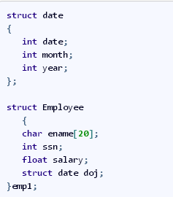
Way 1 (Declare two separate structures)

Slide 15
Accessing Nested Elements
Structure members are accessed using dot operator.
‘date‘ structure is nested within Employee Structure.
Members of the ‘date‘ can be accessed using ’employee’
emp1 & doj are two structure names (Variables)
Explanation Of Nested Structure :
Accessing Month Field : emp1.doj.month
Accessing day Field : emp1.doj.day
Accessing year Field : emp1.doj.year

Slide 16
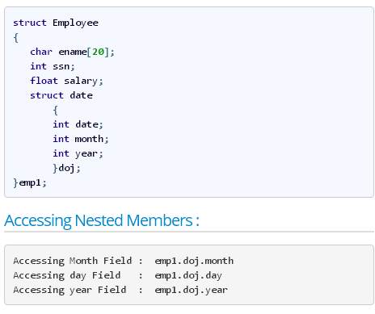
Way 2 (Declare Embedded Structures)

Slide 17
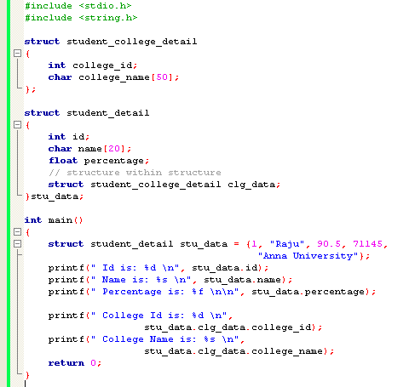

Slide 18
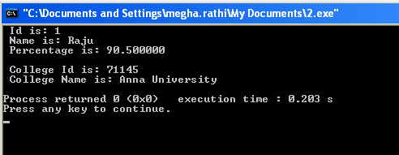

Slide 19
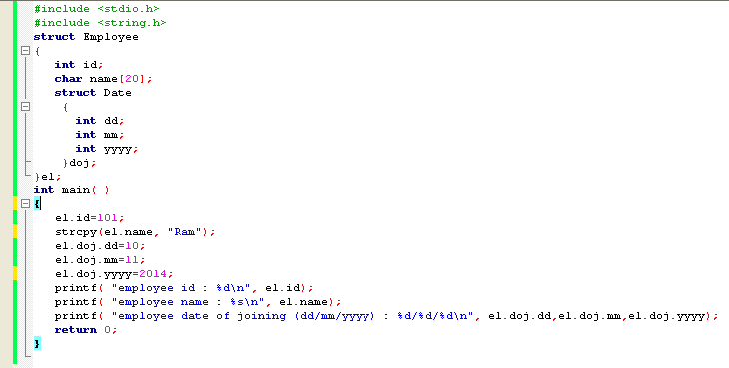

Slide 20
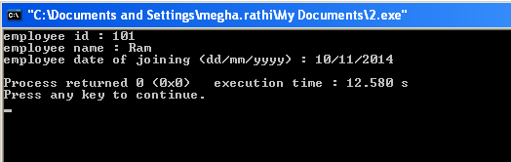

Slide 21
Practice Questions
Consider the given structure. WAP in C to take input for all the data elements from user and then display the information on screen.
struct employee {
char name [100];
int age;
float salary;
struct address {
int houseno;
char street[100’;
}location;
};
2. Design a structure stu_record to contain name, dob, and total marks obtained. Embed Date structure to represent dob which contain elements (day,month and year). Develop a program to read data for 10 students in a class and list them rank-wise.

Slide 22
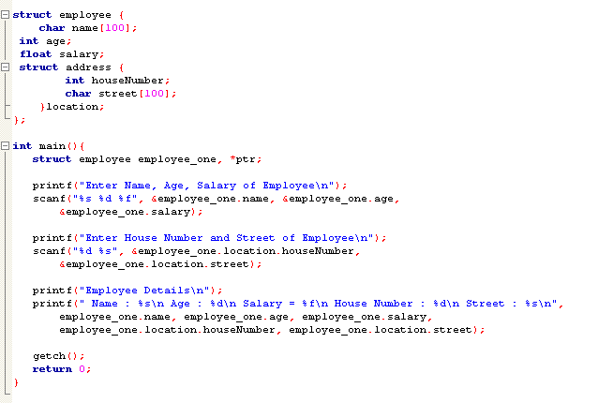

Slide 23
